Slide 1
Planning and Navigation

Slide 2
Competencies for Navigation
Navigation is composed of localization, mapping and motion planning
Different forms of motion planning inside the cognition loop from R. Siegwart
Localization
"Position"
Cognition
Global Map
Environment Model
Path
Local Map
Perception
Real World
Motion Control
Environment

Slide 3
Outline of this Lecture
Motion Planning
State-space and obstacle representation
Work space
Configuration space
Global motion planning
Optimal control (not treated)
Deterministic graph search
Potential fields
Probabilistic / random approaches
Local collision avoidance
BUG
VFH
ND
...

Slide 4
The Planning Problem (1/2)
The problem: find a path in the work space (physical space) from the initial position to the goal position avoiding all collisions with the obstacles
Assumption: there exists a good enough map of the environment for navigation.
Topological
Metric
Hybrid methods

Slide 5
The Planning Problem (2/2)
We can generally distinguish between
(global) path planning and
(local) obstacle avoidance.
First step:
Transformation of the map into a representation useful for planning
This step is planner-dependent
Second step:
Plan a path on the transformed map
Third step:
Send motion commands to controller
This step is planner-dependent (e.g. Model based feed forward, path following)

Slide 6
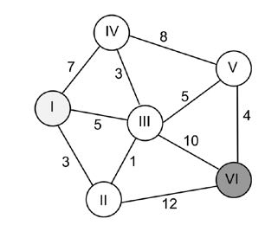
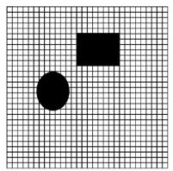
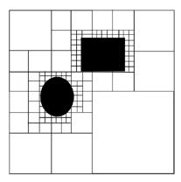
Map Representations
Topological Map
(Continuous Coordinates)
Occupancy Grid Map
(Discrete Coordinates)
K-d Tree Map (Quadtree)
Large memory requirement of grid maps
> k-d tree recursively breaks the environment into k pieces
Here k = 4, quadtree

Slide 7
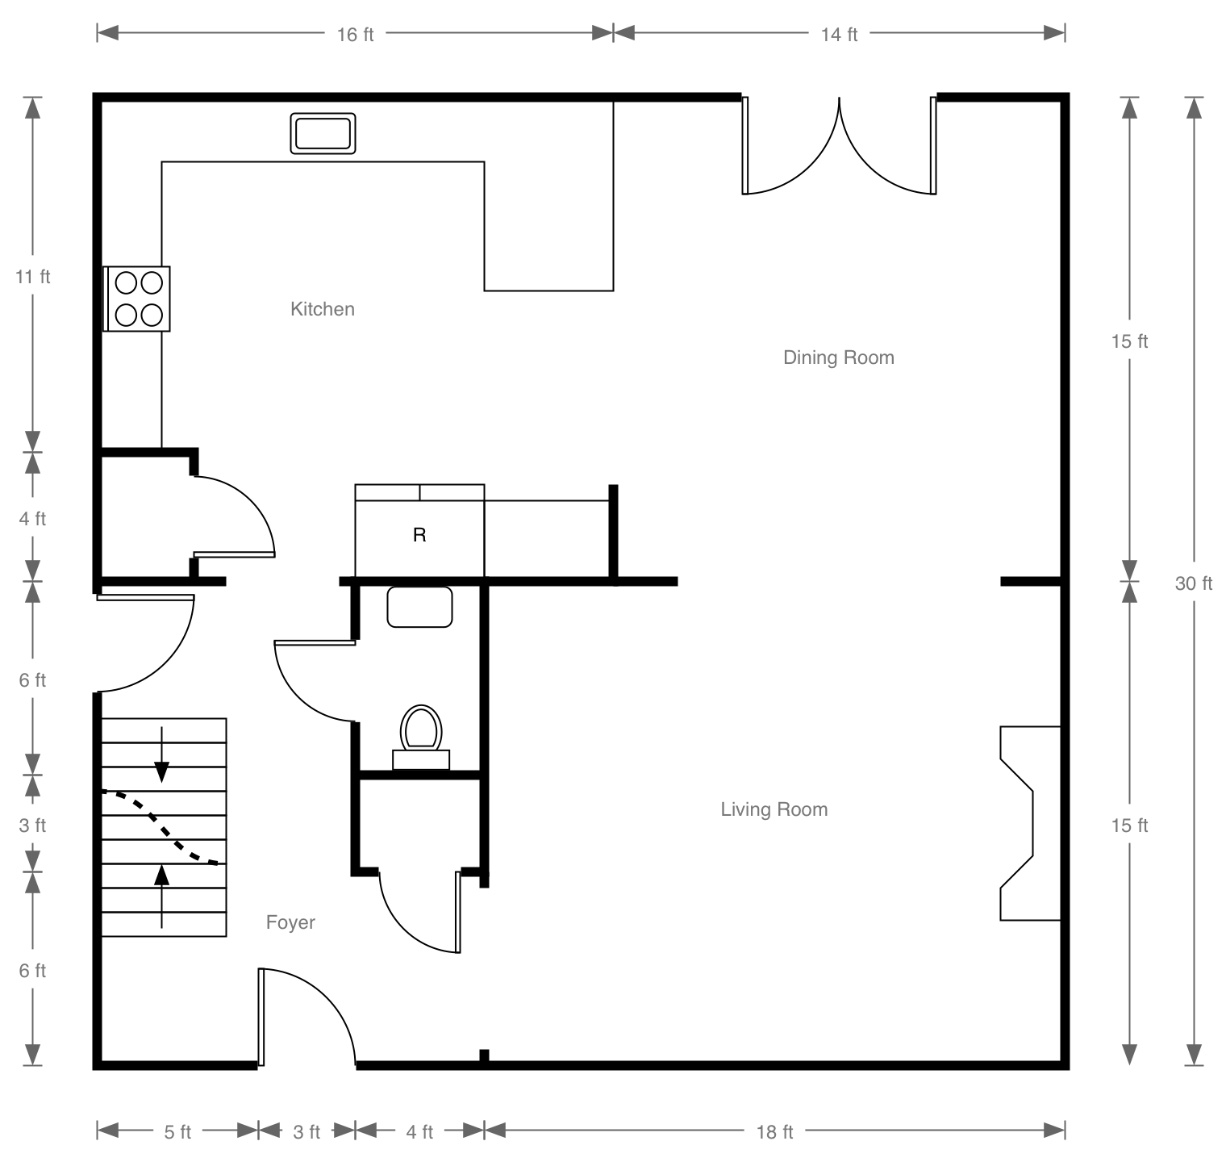
Topological Map

Slide 8
Topological Maps
Edges can carry weights
Standard Graph Theory Algorithms (Dijkstra's algorithm)
Good abstract representation
Several graphs for any world
Assumption: Robot can travel between nodes
Tradeoff in # of nodes:
complexity vs. accuracy
Limited information

Slide 9
Grid World
Two dimensional array of values
Each cell represents a square of real world
Typically a few centimeters to a few dozen centimeters

Slide 10
Alternative Representations
Waste lots of bits for big open spaces
KD-trees
x < 5
free
y<5
occupied
free

Slide 11
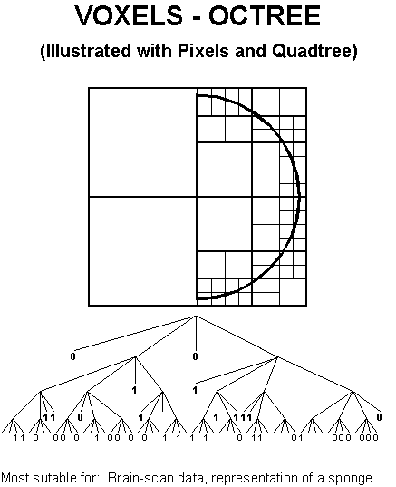
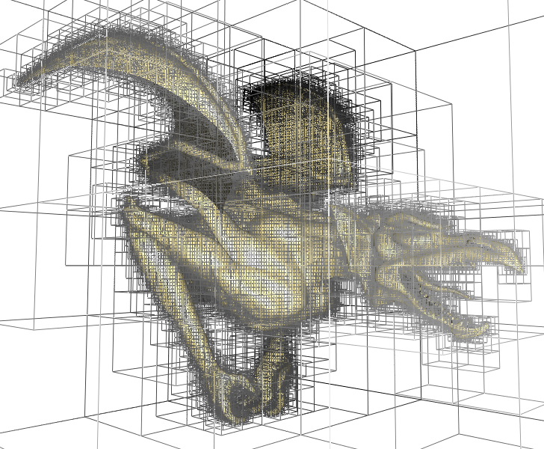
QuadTree OctTree

Slide 12
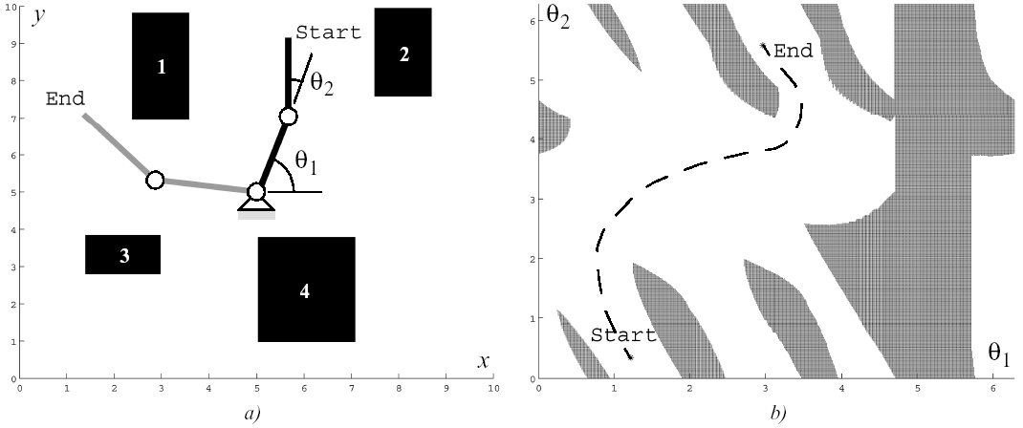
Work Space → Configuration Space
Example: manipulator robots
State or configuration q can be described with k values q_{i}
What is the configuration space of a mobile robot?
Work Space
Configuration Space:
Planning in configuration space
the dimension of this
space is equal to the Degrees of Freedom (DoF)
of the robot

Slide 13
Configuration Space for a Mobile Robot
Mobile robots operating on a flat ground have 3 DoF: (x, y, θ)
For simplification, in path planning mobile roboticists often assume that the robot is holonomic and that it is a point. In this way the configuration space is reduced to 2D (x,y)
Because we have reduced each robot to a point, we have to inflate each obstacle by the size of the robot radius to compensate.

Slide 14
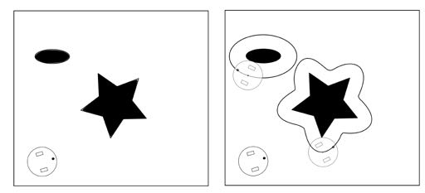
Configuration Space for a Mobile Robot

Slide 15
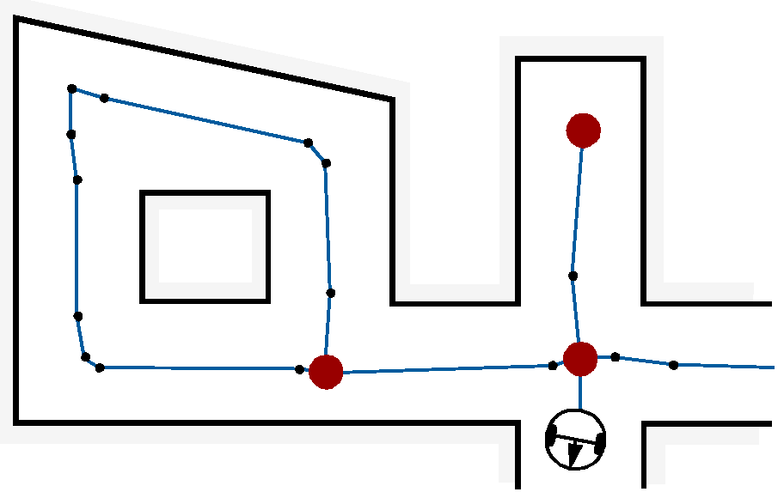
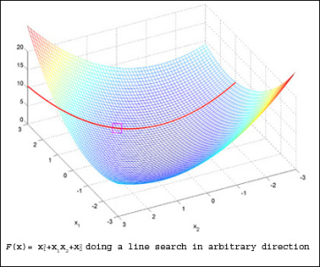
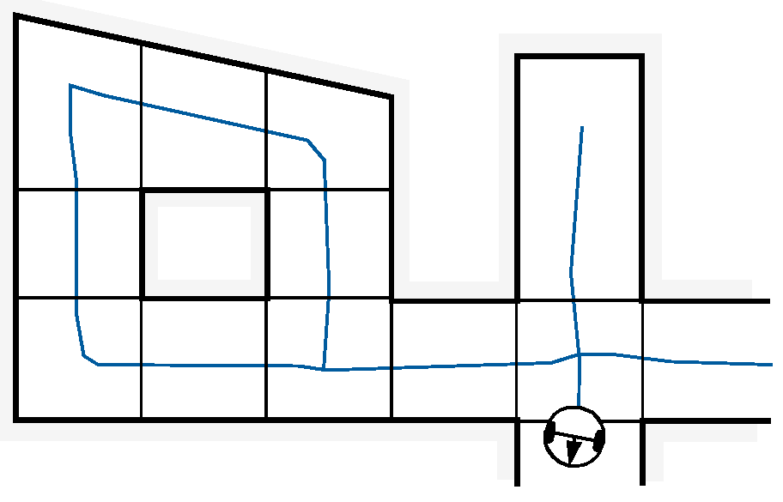
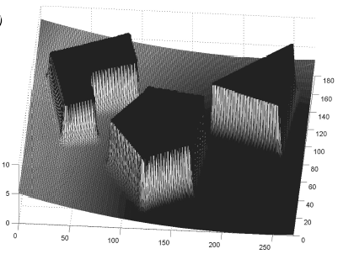
Path Planning: Overview of Algorithms
1. Optimal Control
Solves truly optimal solution
Becomes intractable for even moderately complex as well as nonconvex problems
2. Potential Field
Imposes a mathematical function over the state/configuration space
Many physical metaphors exist
Often employed due to its simplicity and similarity to optimal control solutions
3. Graph Search
Identify a set edges between nodes within the free space
Where to put the nodes?
Source:
http://mitocw.udsm.ac.tz
Configuration Space for a Mobile Robot

Slide 16
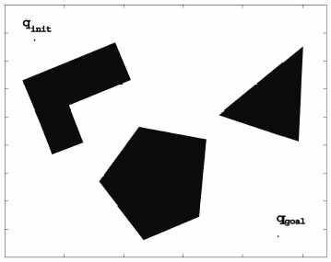
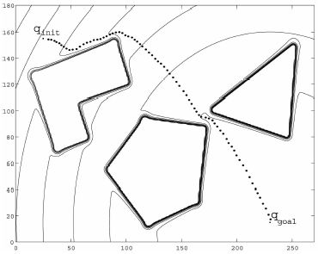
Potential Field Path Planning Strategies
Khatib, 1986
Robot is treated as a point under the influence of an artificial potential field.
Operates in the continuum
Generated robot movement is similar to a ball rolling down the hill
Goal generates attractive force
Obstacle are repulsive forces

Slide 17
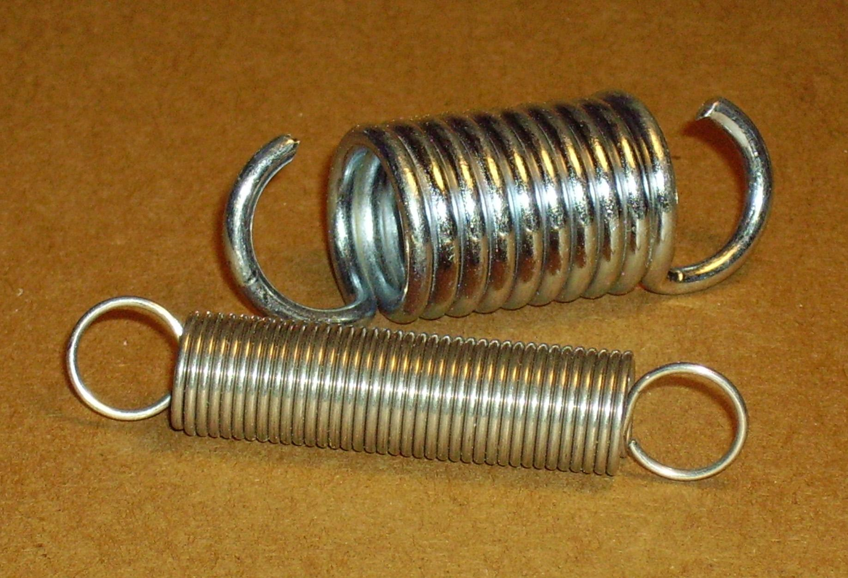
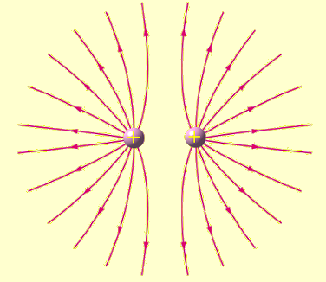
Potential Fields
Oussama Khatib, 1986.
Model navigation as the sum of forces on the robot
Goal: Attractive Force
Large Distance --> Large Force
Model as Spring
Hooke's Law
F = -k X
Obstacles: Repulsive Force
Small Distance --> Large Force
Model as Electrically Charged Particles
Coulomb's law
F= k q₁q₂ / r²

Slide 18
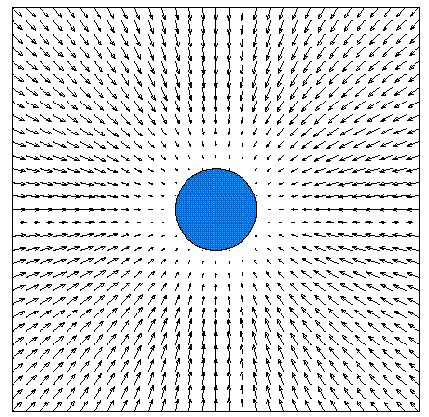
attractive

Slide 19
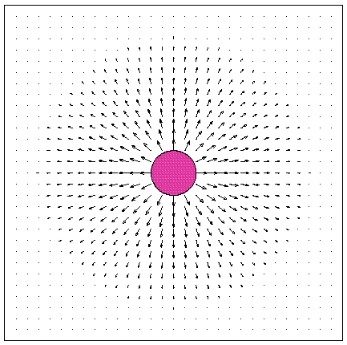
repulsive

Slide 20
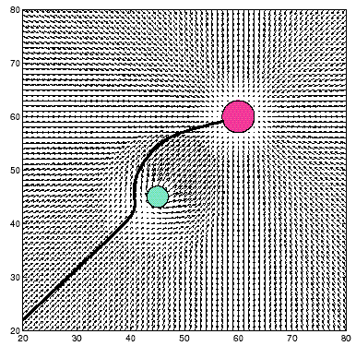

Slide 21
Potential Field Generation
Generation of potential field function U(q)
Generate artificial force field F(q)
Set robot speed (v_{x}, v_{y}) proportional to the force F(q) generated by the field
the force field drives the robot to the goal

Slide 22
Attractive Potential Field
q = [x, y]^{T} q_{goal} = [x_{goal}, y_{goal}]^{T}
Parabolic function representing the Euclidean distance
to the goal
Attracting force converges linearly towards 0 (goal)

Slide 23
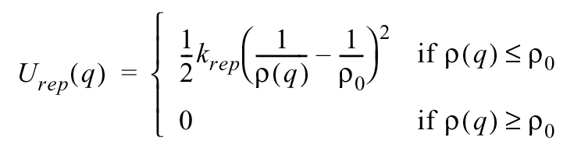
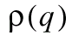
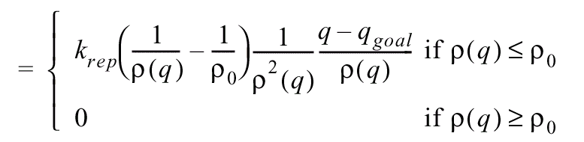
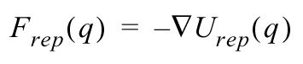
Repulsing Potential Field
Should generate a barrier around all the obstacle
strong if close to the obstacle
not influence if far from the obstacle
minimum distance to the object, ρ₀ distance of influence of object
Field is positive or zero and tends to infinity as q gets closer to the object
obst.

Slide 24
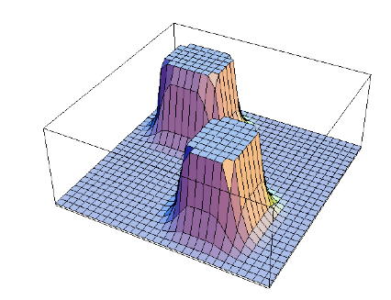
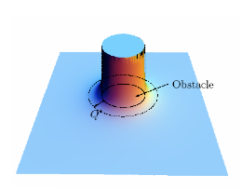
Repulsive potential field

Slide 25
Potential Field Path Planning:
Notes:
Local minima problem exists
problem is getting more complex if the robot is not considered as a point mass
If objects are non-convex there exists situations where several minimal distances exist → can result in oscillations

Slide 26
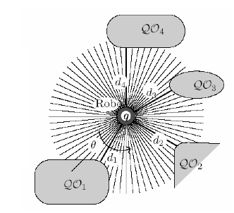
Computing the distance
In practice the distances are computed using sensors, such as range sensors which return the closets distance to obstacles

Slide 27
Graph Algorithms
Methods
Breath First
Depth First
Dijkstra
A* and variants
D* and variants
...

Slide 28
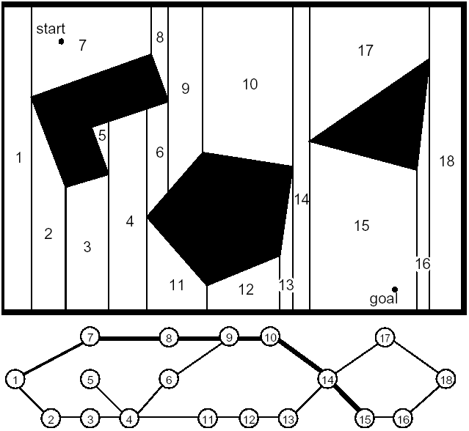
Graph Construction: Cell Decomposition (1/4)
Divide space into simple, connected regions called cells
Determine which open cells are adjacent and construct a connectivity graph
Find cells in which the initial and goal configuration (state) lie and search for a path in the connectivity graph to join them.
From the sequence of cells found with an appropriate search algorithm, compute a path within each cell.
e.g. passing through the midpoints of cell boundaries or by sequence of wall following movements.
Possible cell decompositions:
Exact cell decomposition
Approximate cell decomposition:
Fixed cell decomposition
Adaptive cell decomposition

Slide 29
Graph Construction: Exact Cell Decomposition (2/4)

Slide 30
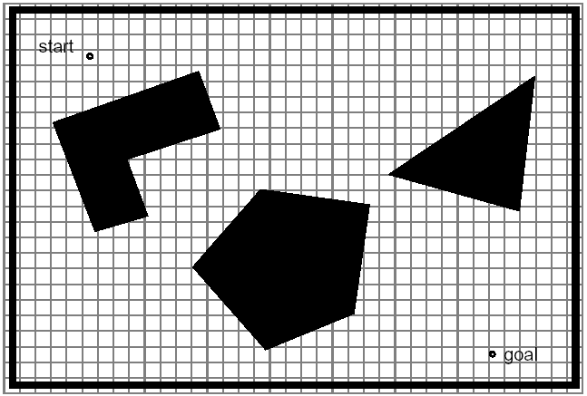
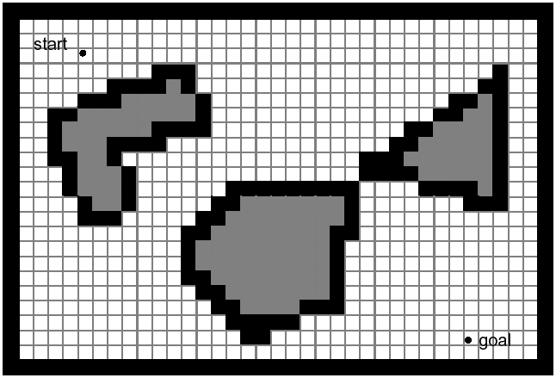
Graph Construction: Approximate Cell Decomposition (3/4)

Slide 31
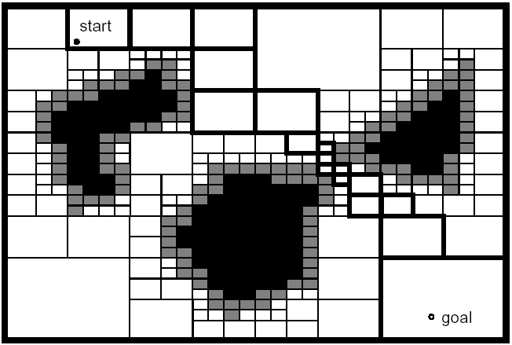
Graph Construction: Adaptive Cell Decomposition (4/4)

Slide 32
Graph Search Strategies: Breadth-First Search

Slide 33
Dijkstra’s Algorithm
A generic path planning problem from vertex I to vertex
VI. The shortest path is I-II-III-V-VI with length 13.
Often highly inefficient
Notes:
Starting from the initial vertex where
the path should start, the algorithm marks all direct neighbors
of the initial vertex with the cost to get there. It then proceeds
from the vertex with the lowest cost to all of its adjacent vertices
and marks them with the cost to get to them via itself
if this cost is lower. Once all neighbors of a vertex have been
checked, the algorithm proceeds to the vertex with the next
lowest cost. Once the algorithm reaches the goal vertex, it terminates
and the robot can follow the edges pointing towards
the lowest edge cost.

Slide 34
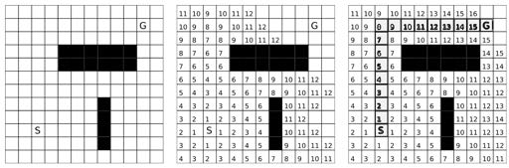
Dijkstra’s Algorithm on a Grid

Slide 35
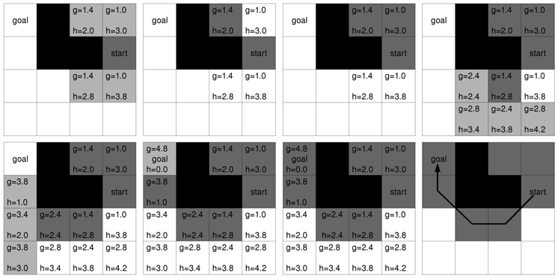
Graph Search Strategies: A* Search
Similar to Dijkstra‘s algorithm, except that it uses a heuristic function h(n)
f(n) = g(n) + ε h(n)

Slide 36
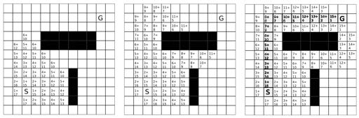
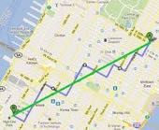
Dijkstra plus directional heuristic: A*

Slide 37
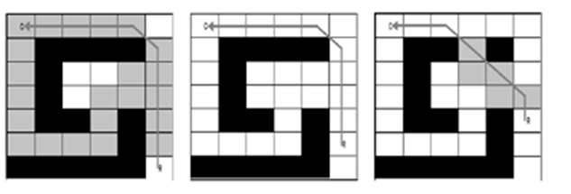
Graph Search Strategies: D* Search
Similar to A* search, except that th search starts from the goal outward
f(n) = g(n) + ε h(n)
First pass is identical to A*
Subsequent passes reuse information from previous searches
For example when after executing the algorithm for a few times, new obstacles appear.

Slide 38
Sampling-based Path Planning (or Randomized graph search)
When the state space is large complete solutions are often infeasible.
In practice, most algorithms are only resolution complete, i.e., only complete if the resolution is ne-grained enough
Sampling-based planners create possible paths by randomly adding points to a tree until some solution is found

Slide 39
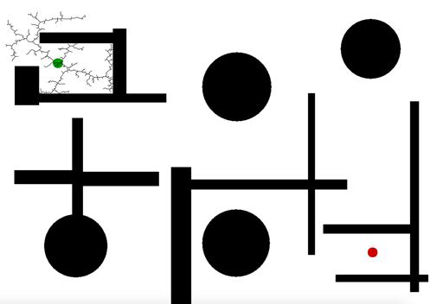
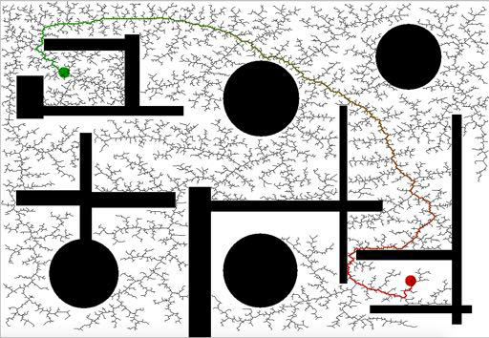
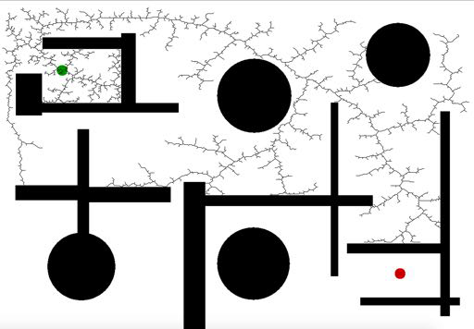
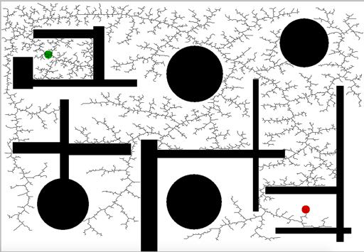
Rapidly Exploring Random Tree (RRT)
Well suited for high-dimensional search spaces
Often produces highly suboptimal solutions

Slide 40
Probabilistic Roadmaps (PRM)
create a tree by randomly sampling points in the state-space
test whether they are collision-free
connect them with neighboring points using paths that reflects the kinematics of a robot
use classical graph shortest path algorithms to find shortest paths on the resulting structure.

Slide 41
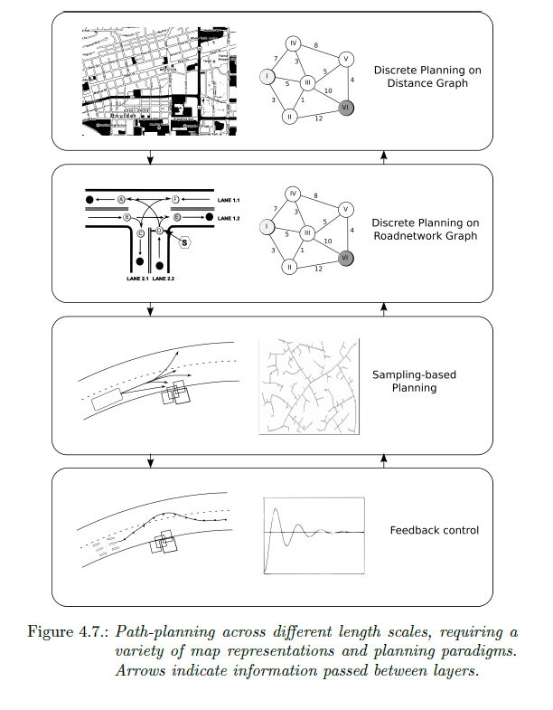
Planning at different length-scales

Slide 42
Take-home lessons
First step in addressing a planning problem is choosing a suitable map representation
Reduce robot to a point-mass by inﬂating obstacles
Grid-based algorithms are complete, sampling-based ones probabilistically complete, but usually faster
Most real planning problems require combination of multiple algorithms

Slide 43
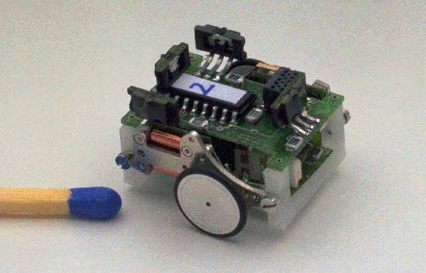
Obstacle Avoidance (Local Path Planning)
The goal of the obstacle avoidance algorithms is to avoid collisions with obstacles
It is usually based on a local map
Often implemented as a more or less independent task
However, efficient obstacle avoidance should be optimal with respect to
the overall goal
the actual speed and kinematics of the robot
the on boards sensors
the actual and future risk of collision
Example: Alice
observed
obstacle
known obstacles (map)
v(t), ω(t)
Planed path
Notes:
goal: avoid obstacles
NOT path following
Creates local commands, usually with goal bias

Slide 44
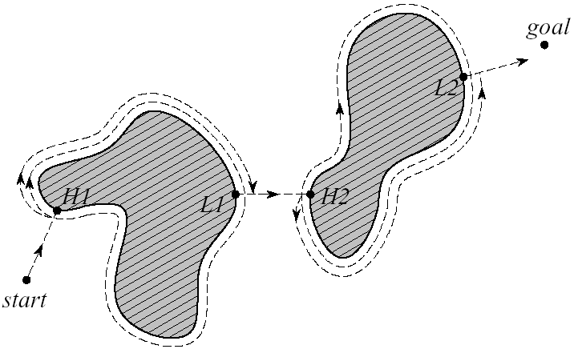
Obstacle Avoidance: Bug1
Following along the obstacle to avoid it
Each encountered obstacle is once fully circled before it is left at the point closest to the goal
Advantages
No global map required
Completeness guaranteed
Disadvantages
Solutions are often
highly suboptimal

Slide 45
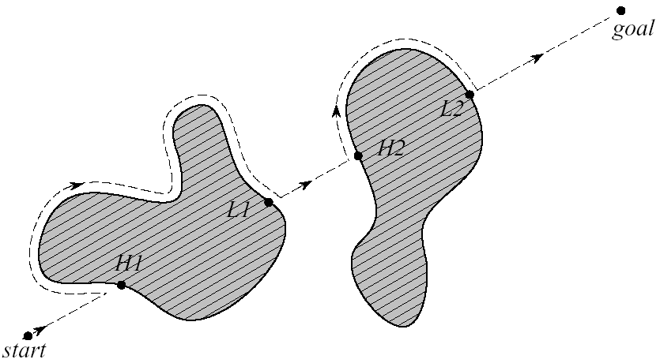
Obstacle Avoidance: Bug2
Following the obstacle always on the left or right side
Leaving the obstacle if the direct connection between start and goal is crossed

